Slide 1

Presentation Skills
By Cheng Ding Xiang
Adapted from, experience

Slide 2
Why Important?
Awards
Project Green Light
FUNDING

Slide 3
Problem Areas
Not natural for most
No Training
FEAR

Slide 4
Getting Good
This stuff is LEARNED, and competency in it comes from PAST SUCCESS and POSITIVE FEEDBACK!

Slide 5
Getting Control
Plan
Prepare
Practice

Slide 6
Presentation Support
Should help trigger your thoughts and points
Reinforce your points visually, a picture paints a thousand words
No More than THREE points on any slide

Slide 7
Rehearse
Out LOUD
With others
3 – 4 Times

Slide 8
Rehearse
The effort to use nice words that you are not used to saying can make you forget your points
Best to speak confidently with the words you are confident with

Slide 9
Rehearse
If certain words are really good but not in your usual vocabulary, practise it more.
Find your rhythme and flow
Refer to the movie, The King’s Speech

Slide 10
Rehearse
Get critiques/reflections:
What are your habits?
What works for you?
What works against you?

Slide 11

Dealing with Fear
And some awkwardness

Slide 12

Fear and Awkwardness
Stage fright is normal

Slide 13
In the mind
First time audience has no idea how your presentation should go.
If you make a mistake, that audience would not know
Stay cool and just run with it

Slide 14
In the body
Focus on the eyes of individuals in the audience
Do not try to “take on” the entire audience
Start with one person, and shift focus to another from time to time
DO NOT KEEP READING OFF THE SLIDES

Slide 15
Identity & Intent
Awkwardness in communication typically comes from an unclear “identity”
Without clear “intent”, you will easily lose your train of thought
Dragging and delays will make you even more nervous

Slide 16
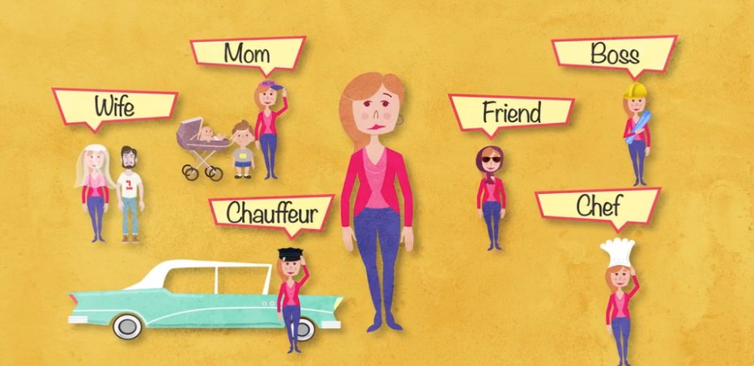
Identity
We all have many
Choose one for the presentation

Slide 17
Intent
Be clear on the goal of the presentation
What are the main points
What should the audience take away

